Slide 1
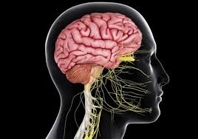
REVISION IN CNS
BY
DR.G.AARTHIPRIYANKA
POSTGRADUATE
DEPARTMENT OF PHARMACOLOGY
RMMC

Slide 2
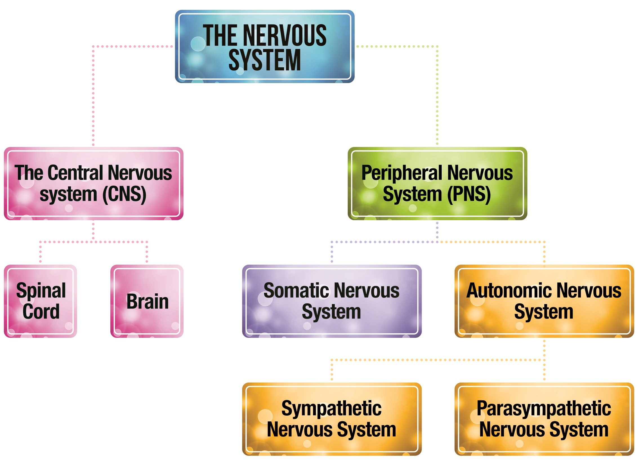

Slide 3
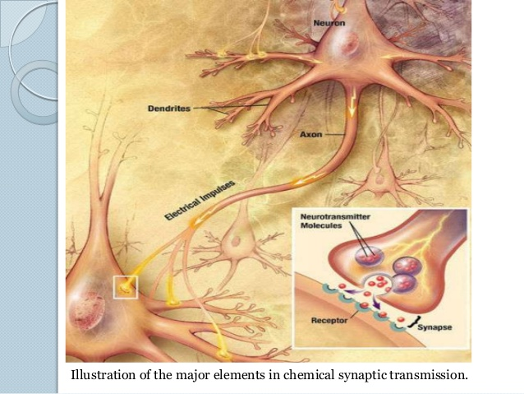

Slide 4
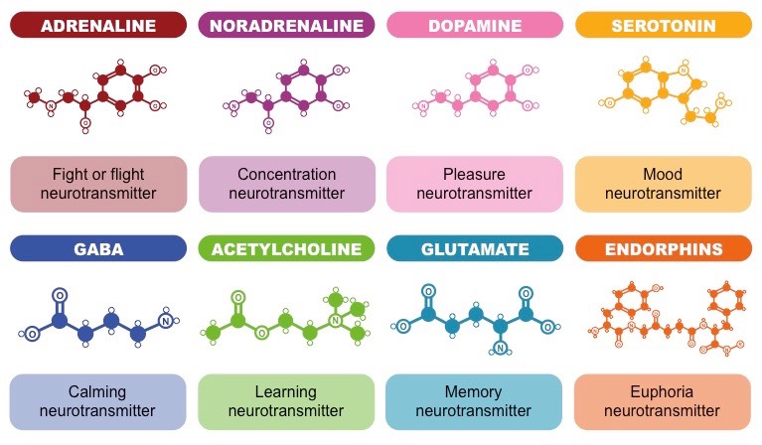

Slide 5
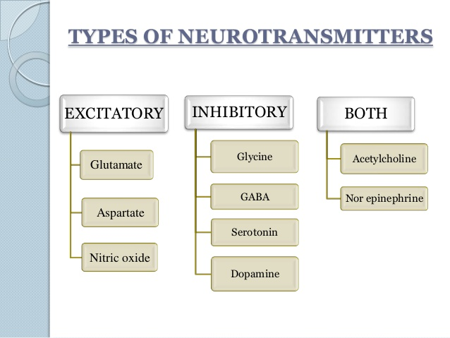

Slide 6
CNS DEPRESSION | CNS STIMULATION
DROWSINESS | EXCITEMENT
SEDATION | EUPHORIA
HYPNOSIS | INSOMNIA
DISORIENTATION | TREMORS
CONFUSION | TWITCHING
UNCONSIOUSNESS | CONVULSIONS
COMA,DEATH | COMA,DEATH

Slide 7
TOPICS TO BE REVISED
GENERAL ANAESTHETICS
SEDATIVE,HYPNOTICS,ALCOHOL
ANTIEPILEPTIC DRUGS
OPIOIDS
COGNITIVE ENHANCERS
PSYCHOPHARMACOTHERAPY-DEPRESSION,MANIA,PSYCHOSIS,ANXIETY

